Slide 1

Housing Values in suburbs of Boston
Apoorva & abhilash
Math 240 project
Instructor: jane Sherman
Spring 2016
Golden gate university

Slide 2
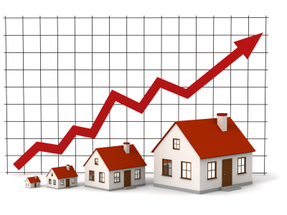
Agenda
Introduction
Variables
Overview
Regression Process
Interpretation
Residual Plots
Conclusion

Slide 3
Introduction
This data set to be analyzed were collected by Harrison and Rubinfeld of University of Michigan for the purpose of discovering whether or not clean air influenced the value of houses in Boston
Our analysis on the dataset seeks to examine the influence of several neighborhood attributes on the prices of housing
The specific attributes to be considered are proximity to the Charles River, distance to the main employment centers, pupil-teacher ratio in schools, and levels of crime
The original study focused on air pollution using nitrogen oxide concentrations as an explanatory variable
Our analysis is to examines whether or not there are other, better explanatory variables for the median value of houses in Boston

Slide 4
Understanding the Data
Variable Name | Definition
MEDV | median value of owner-occupied homes in $1000
DISTANCE | Weighted mean of distance to Boston employment centers
CRIM | Per capita criminal rate by town
RADIAL | Index of accessibility to radial highways
ZONED | Proportion of residual land zoned for lots
INDUS | Proportion of non-retail business acres per town
Tax | Property tax/$10000
CHAS | 1 on Charles rives, 0 else
PTRATIO | Pupil/ Teacher ratio by town
NOX | Nitrogen oxide Concentration(Parts per million)
LSTAT | % Lower-status of the population
AGE | % owner-occupied units built before 1940
RM | Average number of rooms per dwelling
BK | % Blacks by town. 1000(Bk-0.63)^2

Slide 5
Overview
MedV is our dependent variable and other 13 are Independent variables with 99% confidence Interval.
The goal of our analysis is to find a regression model that best explains the variation in medv.
Step 1: Multiple regression was conducted on the data set using the transformations as appropriate, with 13 independent variables. Some independent variables which were not significant were removed in the regression process.
Step 2: Residual analysis using scatterplots
From the model thus obtained, inferences can be drawn about the data and conclusions can be made about the most important factors that explain the variation in housing prices.

Slide 6
Step 1: Regression process
VIF analysis – Radial Highways(9.02)
CP Analysis
P-Value
Finally left with 7 independent variables- CHAS, NOX, Rooms, Distance, PTRatio, Bk, Lstat
Regression equation
MedV =16.4264 +2.76749 * CHAS - 11.5252* NOX+ 5.4698* rooms-0.98295* distance-0.842* PTRation+ 0.0115* Bk- 0.54799* LSTAT
Where median house value is in $1000 & Nitrogen oxide concentration is in PPM. Distance in miles.
Regression | 1st | 2nd | 3d | 4th | 5th
Not significant | INDUS | AGE | TAX | CRIME RATE | ZONED
P-value | 0.904 | 0.502 | 0.1553 | 0.338 | 0.0176

Slide 7
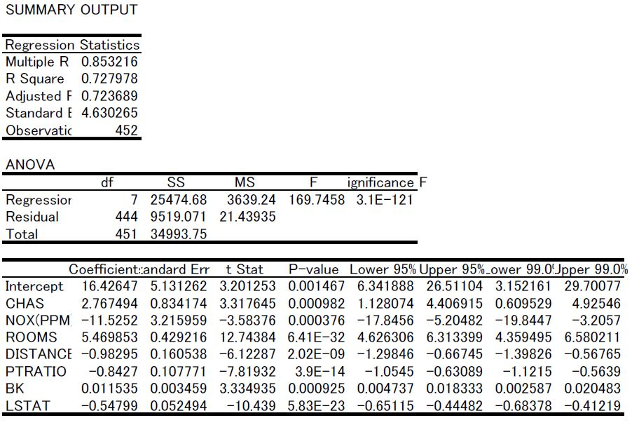

Slide 8
Interpretation of Results
Correlation of Determination(R^2): 0.7279
72.79% of the variation of the house prices are explained by variation in the variables NOX,
CHAS, Rooms, Distance, PTRation, Bk, LStat
Correlation Coefficient (Multiple R): 0.8532
The average number of rooms is positively correlated with house price
There is also a positive correlation if the house is next to the Charles River.
Negative correlations with pupil-teacher ratios
Distance to the main employment centers and nitrogen oxide levels significantly influence the house prices. There is Negative correlations with both variables.
Adjusted R^2: 0.7236
72.36% of the variation of the house prices are explained by variation in the variables NOX,
CHAS, Rooms, Distance, PTRation, Bk, LStat

Slide 9
Step 2: Residual Plots- Observations
Quadratic pattern in residual plot of rooms and exponential patterns in plots of distance and Lstat
Added Room^2, ln(Distance) &ln(Lstat)
Result: Better residual plots

Slide 10
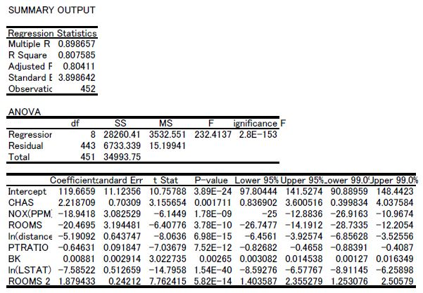

Slide 11
New Regression Equation
MedV =119.6659 +2.218709 * CHAS - 18.9418* NOX-20.4695* Rooms-5.19092*ln(distance)-0.6463* PTRation+ 0.00881* Bk- 7.58522*ln( LSTAT)+1.8794*Room^2
CHAS = 0
MedV =119.6659 - 18.9418* NOX-20.4695* Rooms-5.19092*Ln(distance)- 0.6463* PTRation+ 0.00881* Bk- 7.58522* LSTAT+1.8794*Room^2
CHAS = 1
MedV =121.884- 18.9418* NOX-20.4695* Rooms-5.19092*Ln(distance)-0.6463* PTRation+ 0.00881* Bk- 7.58522* LSTAT+1.8794*Room^2

Slide 12
Conclusion:
House prices are higher in areas with lower pupil-teacher ratios
This analysis is based on the neighborhood attributes of houses, so the number of rooms is not an important variable.
The interesting factors to consider is nitrogen oxide levels. Higher the level of Nox, house prices decrease to a greater extent
As the distance to main employment center increases, the house price decreases
House prices decreases as the Lower-status population increases
House prices increases to certain extent with increase in % of Bk and if house is nearer to Charles River.

Slide 13

Thank You!

Slide 14
References
Harrison, D. and Rubinfeld, D.L. (1978) Hedonic prices and the demand for clean air. J. Environ. Economics and Management 5 , 81–102.

